Slide 1

Adiabatic Lapse Rate
Dr Indranil Ghosh

Slide 2

Change of Temperature with Altitude under Adiabatic Condition

Slide 3

Recapitulation
Lapse Rate
The change of temperature of air with respect to height or altitude is called Lapse rate.
Environmental Lapse Rate (ELR)
Adiabatic Lapse Rate (ALR)

Slide 4
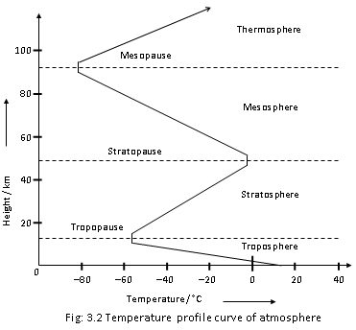

Slide 5
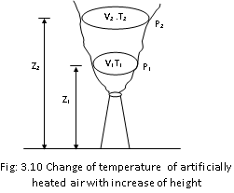
Adiabatic Lapse rate

Slide 6
According to the first law of thermodynamics (law of conservation of energy),
dq= dU+dW
Under the adiabatic condition, dq=0
So, 0= dU+dW
Or, dW=-dU [- ve sign is indicating the work done at the
cost of internal energy]
Or, dW= -C_{v} dT [dU= C_{v} dT ]
The above equation is indicating that in adiabatic condition, the temperature would be reduced if the work is done by the system (as C_{v} = constant). This rate of change in temperatures with respect to height is known as Adiabatic Lapse Rate.

Slide 7
There are two different types of Adiabatic Lapse Rate (ALR) –
Dry Adiabatic Lapse Rate (DALR)
Saturated Adiabatic Lapse Rate (SALR)

Slide 8
Dry Adiabatic Lapse Rate (DALR)
When the artificially heated air is dry and the temperature is more than the dew point temperature (the temperature at which dew is formed), the adiabatic lapse rate is called Dry Adiabatic Lapse Rate (DALR). The Dry Adiabatic Lapse Rate (DALR) is constant at -10ºC/ Km

Slide 9
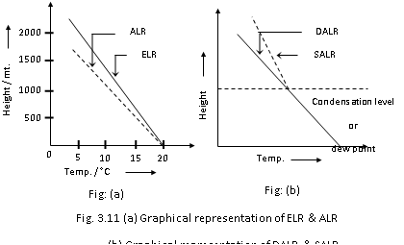
Saturated adiabatic Lapse Rate (SALR)
When the artificially heated air is saturated by moisture and temperature is less than the dew point temperature, the adiabatic lapse rate is called Saturated Adiabatic Lapse Rate or Wet Adiabatic Lapse Rate (SALR). The average SALR is -5.6ºC/Km
The artificially heated air normally neither fully dry nor fully saturated and so actual ALR is in between DALR and SALR i.e., in between -10ºC/Km and -5.6ºC/Km

Slide 10
Change of Temperature with Altitude under Adiabatic Condition

Slide 12
The above equation is indicating how temperature of atmosphere is changing with respect to the pressure of the atmosphere. Now we will establish the relationship between pressure and altitude.

Slide 13
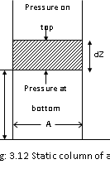

Slide 15


Thank You
Dr Indranil Ghosh
indranilghosh74@gmail.com

